Slide 1

SMART Personalized Customer Support
AI-powered personalized customer support assistant using the GenAI and MongoDB. By integrating customer data from MongoDB, the chatbot will generate tailored responses, leveraging GPT-4's advanced language capabilities to enhance user experience.
Team 06:
Kavish Nayeem (Project lead, Software Architect)
Mohammed Abdul Rahman (Backend Engineer)
Mohammed Farhan Wajid (Front-End Engineer)
Mohtashim Maaz Syed (Data Specialist)

Slide 2



Core Architecture Overview
React (Customer & Agent) Frontend
1
User interface and interaction
Node.js, Express.js & Socket.io Backend
2
Request handling and API integration
MongoDB Database
3
Data storage and retrieval
The Customer Support Chat Application is built on a robust three-tier architecture. The React-based frontend provides a dynamic and responsive user interface. The Node.js and Express backend efficiently handles requests and integrates with external APIs. MongoDB serves as the reliable data store, housing user profiles, chat histories, and support records.

Slide 3
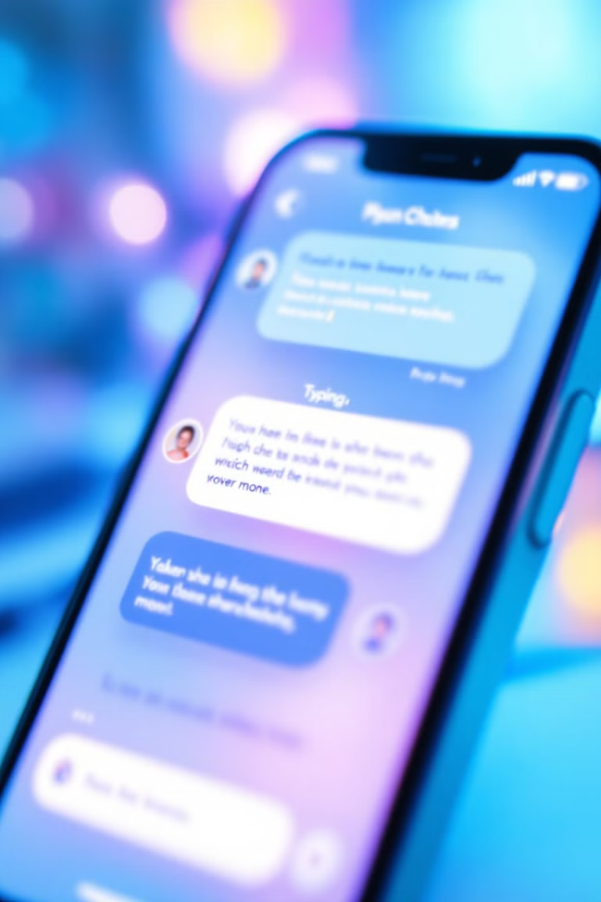




Frontend Features and Functionality
Message Interface
Loading Indicators
Intuitive chat UI with real-time updates
Visual feedback for ongoing processes
User Authentication
State Management
Secure login and session management
React hooks for efficient data handling

Slide 4





Backend Processing and API Integration
Request Handling
Data Retrieval
OpenAI Integration
Response Delivery
Validate and process user inputs
Fetch user-specific information from MongoDB
Generate intelligent, context-aware responses
Send personalized support back to the user

Slide 5

Real-Time Communication with Socket.io
1
2
3
4
Connection Establishment
Agent Availability Check
Agent Assignment
Real-Time Interaction
Available agent is connected to the user's chat
User initiates chat and socket connection is created
System verifies if human agents are available
Instant message exchange between user and agent

Slide 6
Personalization through Prompt Engineering
User-Specific Data
AI Response Generation
Name and account number
Contextual understanding
Location and time zone
Tailored language and tone
Recent purchase history
Product-specific knowledge
Previous support interactions
Personalized recommendations
Prompt engineering is a crucial aspect of our AI-powered responses. By incorporating user-specific information into the prompts sent to the OpenAI API, we ensure that the generated responses are highly relevant and personalized. This attention to detail creates a supportive and engaging customer service experience that feels tailored to each individual user.

Slide 7
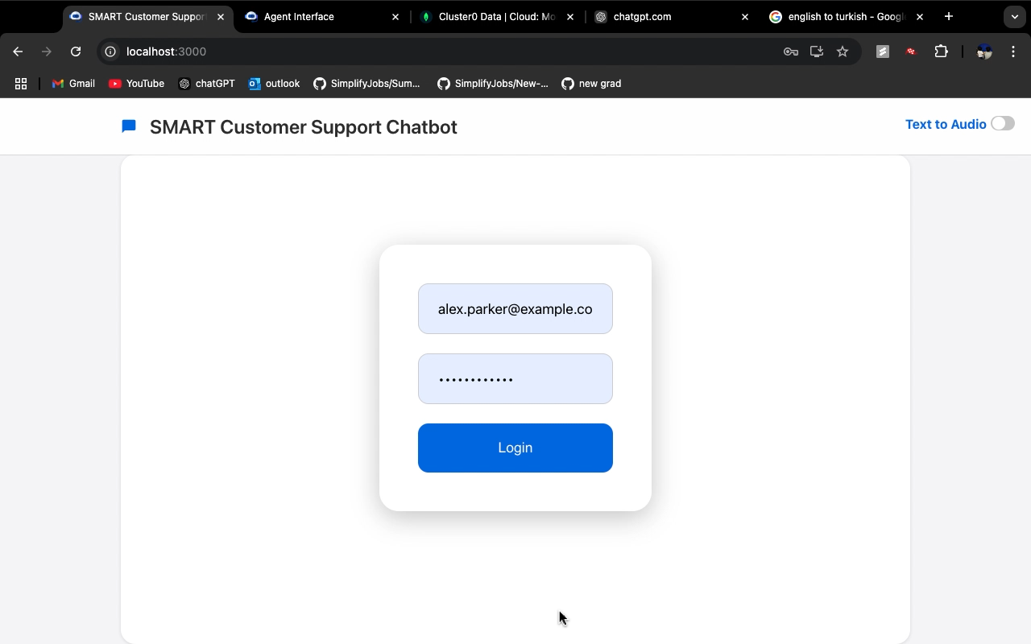

Slide 8
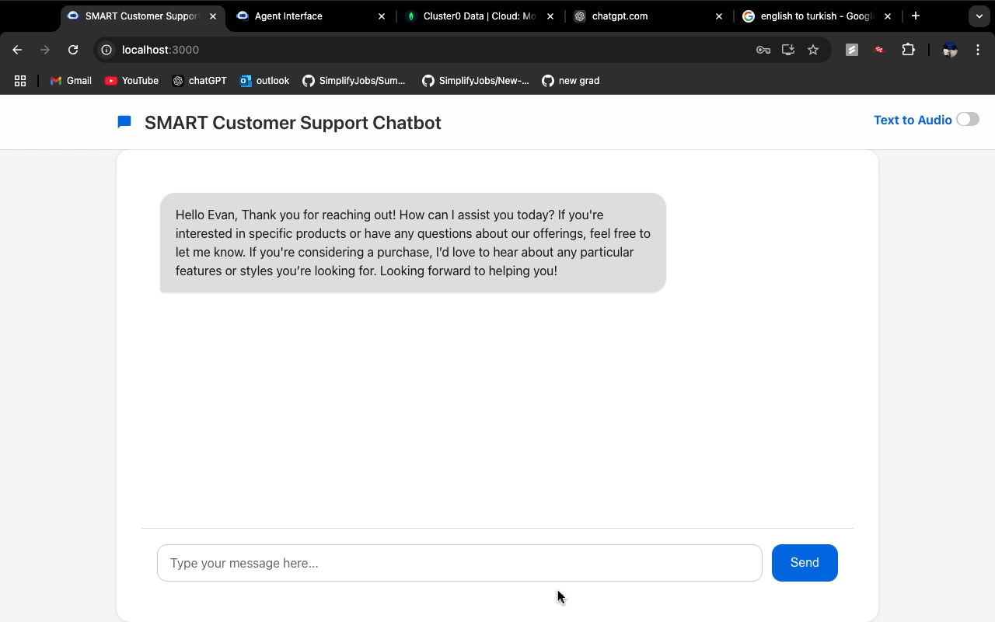

Slide 9
Thank You

